Slide 1
Vehicle
speed
alert and
accident detection system

Slide 2
Table of Contents
1
2
3
4
5
Motivation
Introduction
Proposed Idea
Conclusion
Timeline

Slide 3

1
Motivation

Slide 4
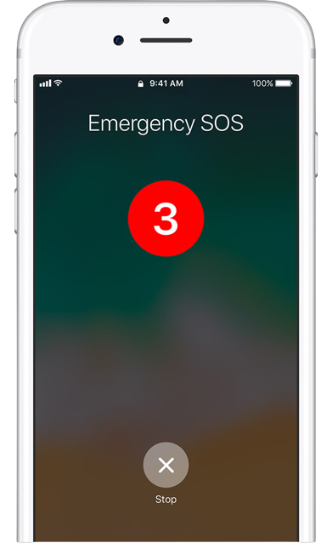
Primary Motto
These days we can see that the graph of accidents per day are rising.
The hard part comes when a person dies in an accident without having any help in that situation. To counteract that type of helpless situation, we are doing this project to send an emergency SOS when an accident occurs.

Slide 5
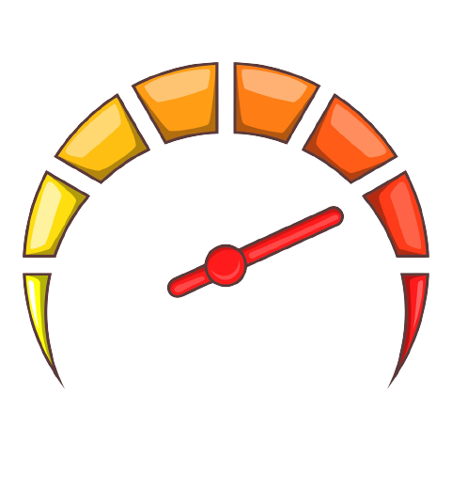
Speed Factor
Excessive speed is a key risk factor for road accidents and greater severity of the injuries in the event of a crash.

Slide 6

Why Is It Important ?
Vehicle crash and accident alert systems
are important because they can help
prevent injuries and fatalities on
the road.
Vehicle crash and accident alert
systems are important because they can
help prevent injuries and fatalities on the road.

Slide 7
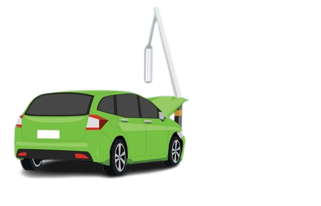
2
Introduction
Our project tries to save lives of people who are prone to accidents.

Slide 8
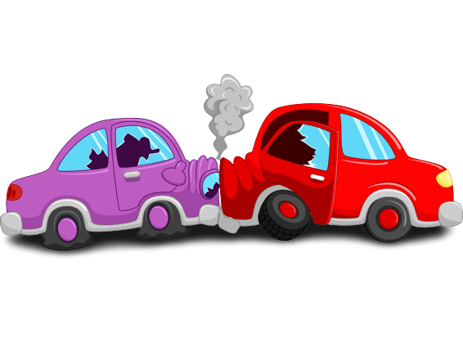
Introduction
Our project is based on real time vehicle speed alert and accident detection system.
It shares real time gps signal to the app with the help of longitudes and latitudes.
It also monitors the speed of the vehicle and alerts us if it crosses a particular speed limit.

Slide 9

This device also alerts us if in case of any accident when the device changes its angle more than or equal to 90 degrees which is a likely accidental angle.
There are systems that send alert information when the accident occurs, but systems that trace out the location of the spot do not exist.

Slide 10
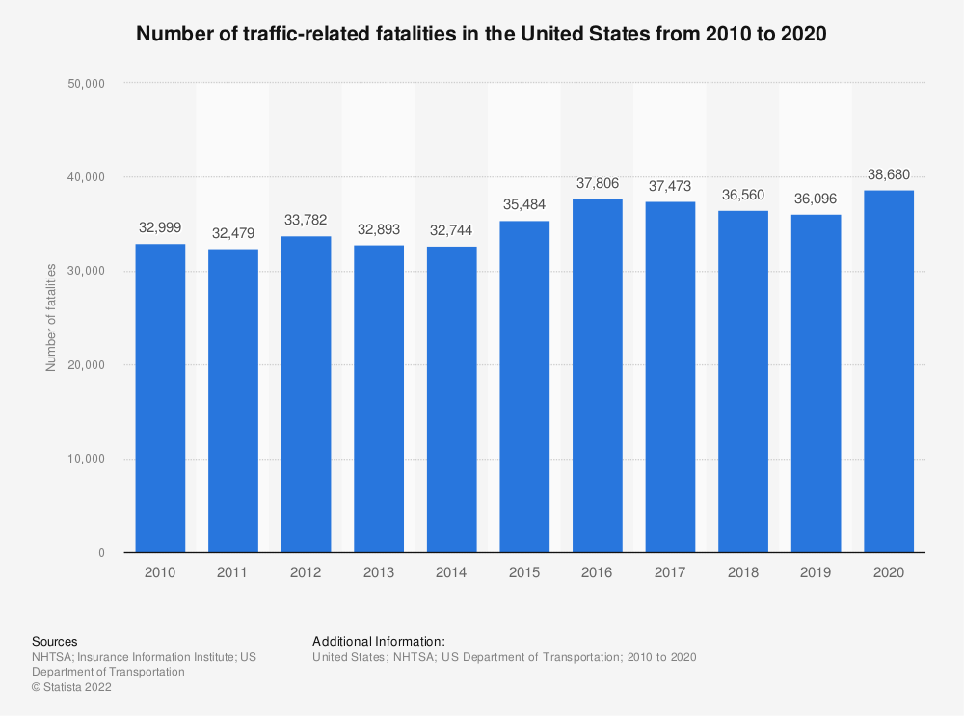
Graph showing accidents

Slide 11

Primary Benefits
Improved safety: These systems can help reduce the number of accidents on the road and improve overall safety for drivers and passengers.
Early warning: Crash and accident alert
systems can provide early warning to drivers
of potential dangers, giving them time to take
action and avoid a collision.

Slide 12
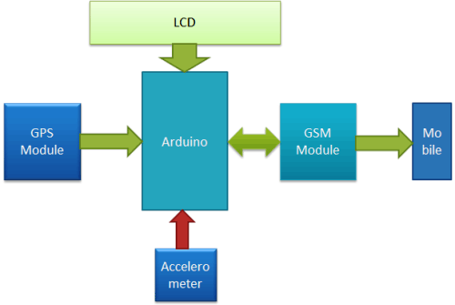

Slide 13
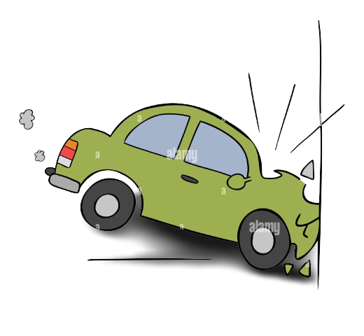
3
Proposed Idea

Slide 14
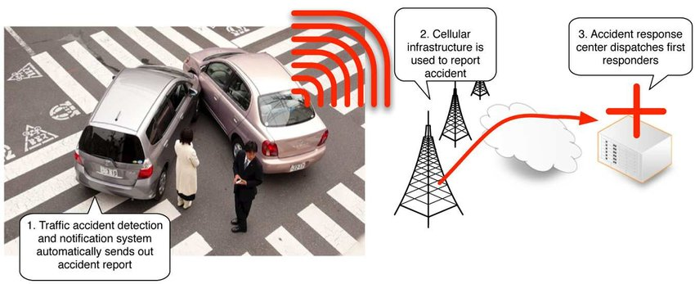
The project aims at finding the vehicle where it is and locating the vehicle using a GPS within the vehicle system to send a message.

Slide 15


Informing the emergency contacts set by the user that an accident has occurred so that their immediate family or friends are aware of the situation.
Providing the exact location of the vehicle in the form of latitude and longitude coordinates in order to decrease the response time of the emergency services using the GPS module.

Slide 16

Security enhancement :
This proposed work is an attempt to design an advance vehicle security system that uses GPS and GSM system to prevent theft and to determine exact location of vehicle.
The safety of the vehicle is exceptionally
essential these days as thefts are
increasing gradually over the days.

Slide 17
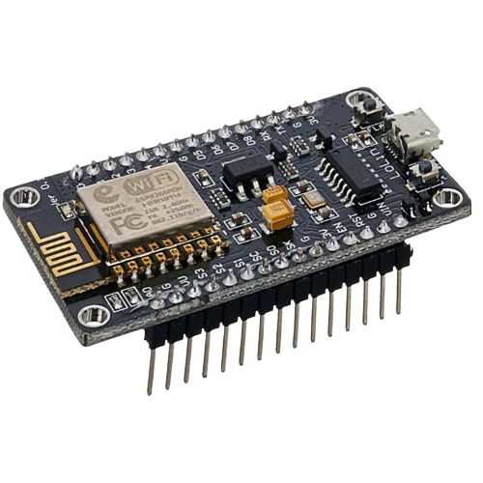
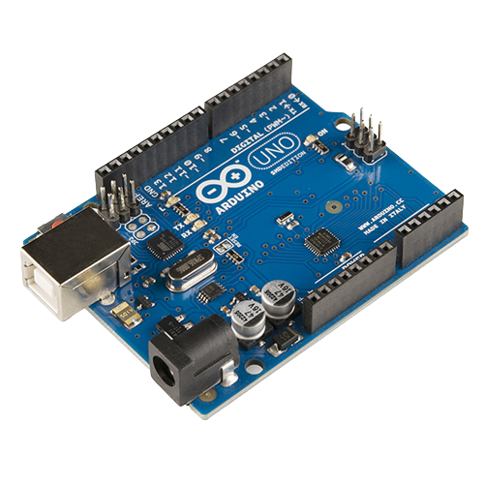
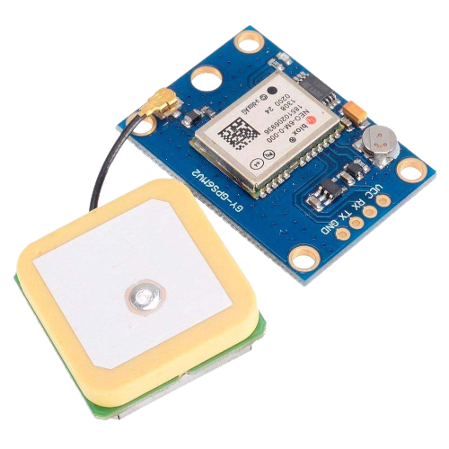
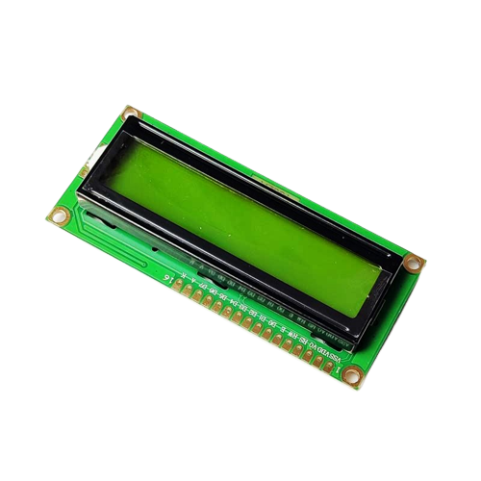
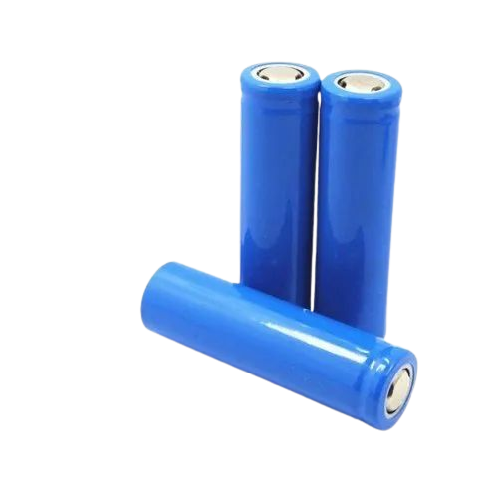
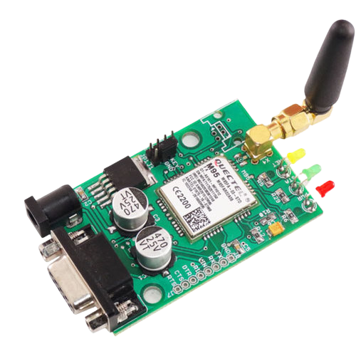
Parts
1. Arduino Uno
2.Node MCU
3.GPS Module
4.LCD Display
5.Li-ion batteries
6. GSM Module

Slide 18
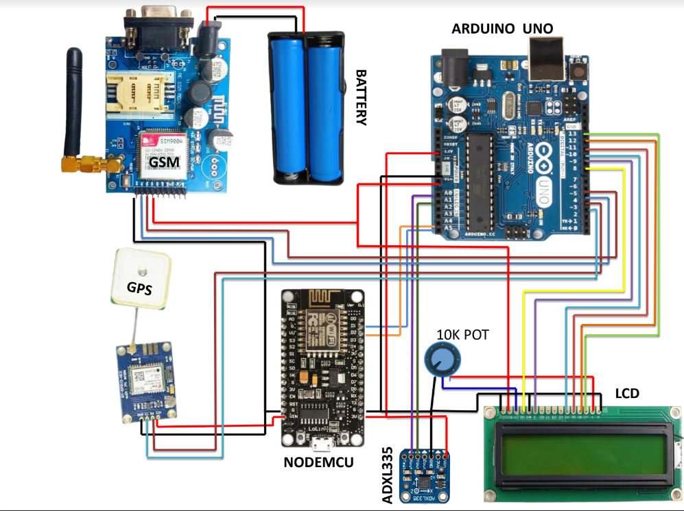

Slide 19
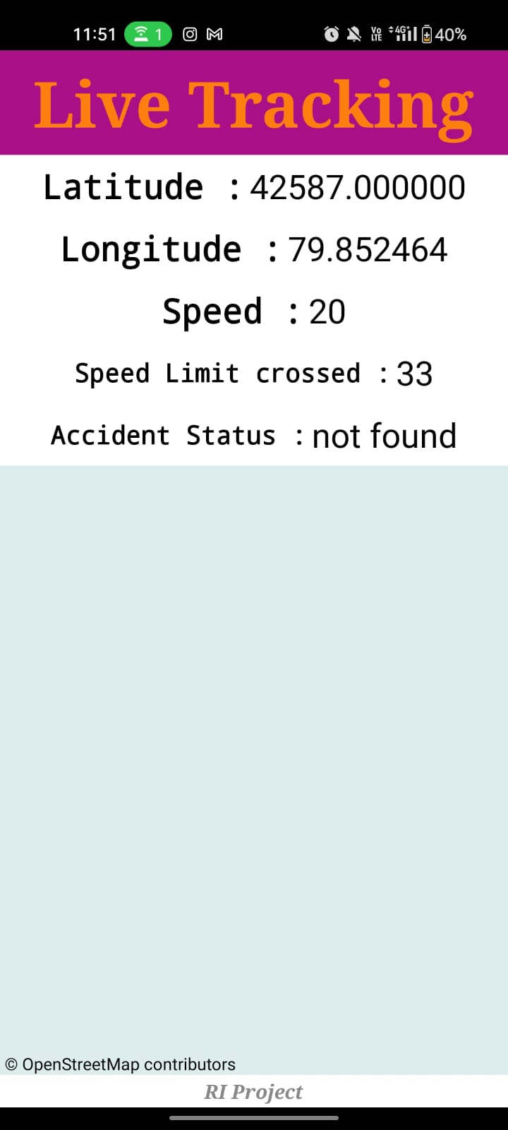
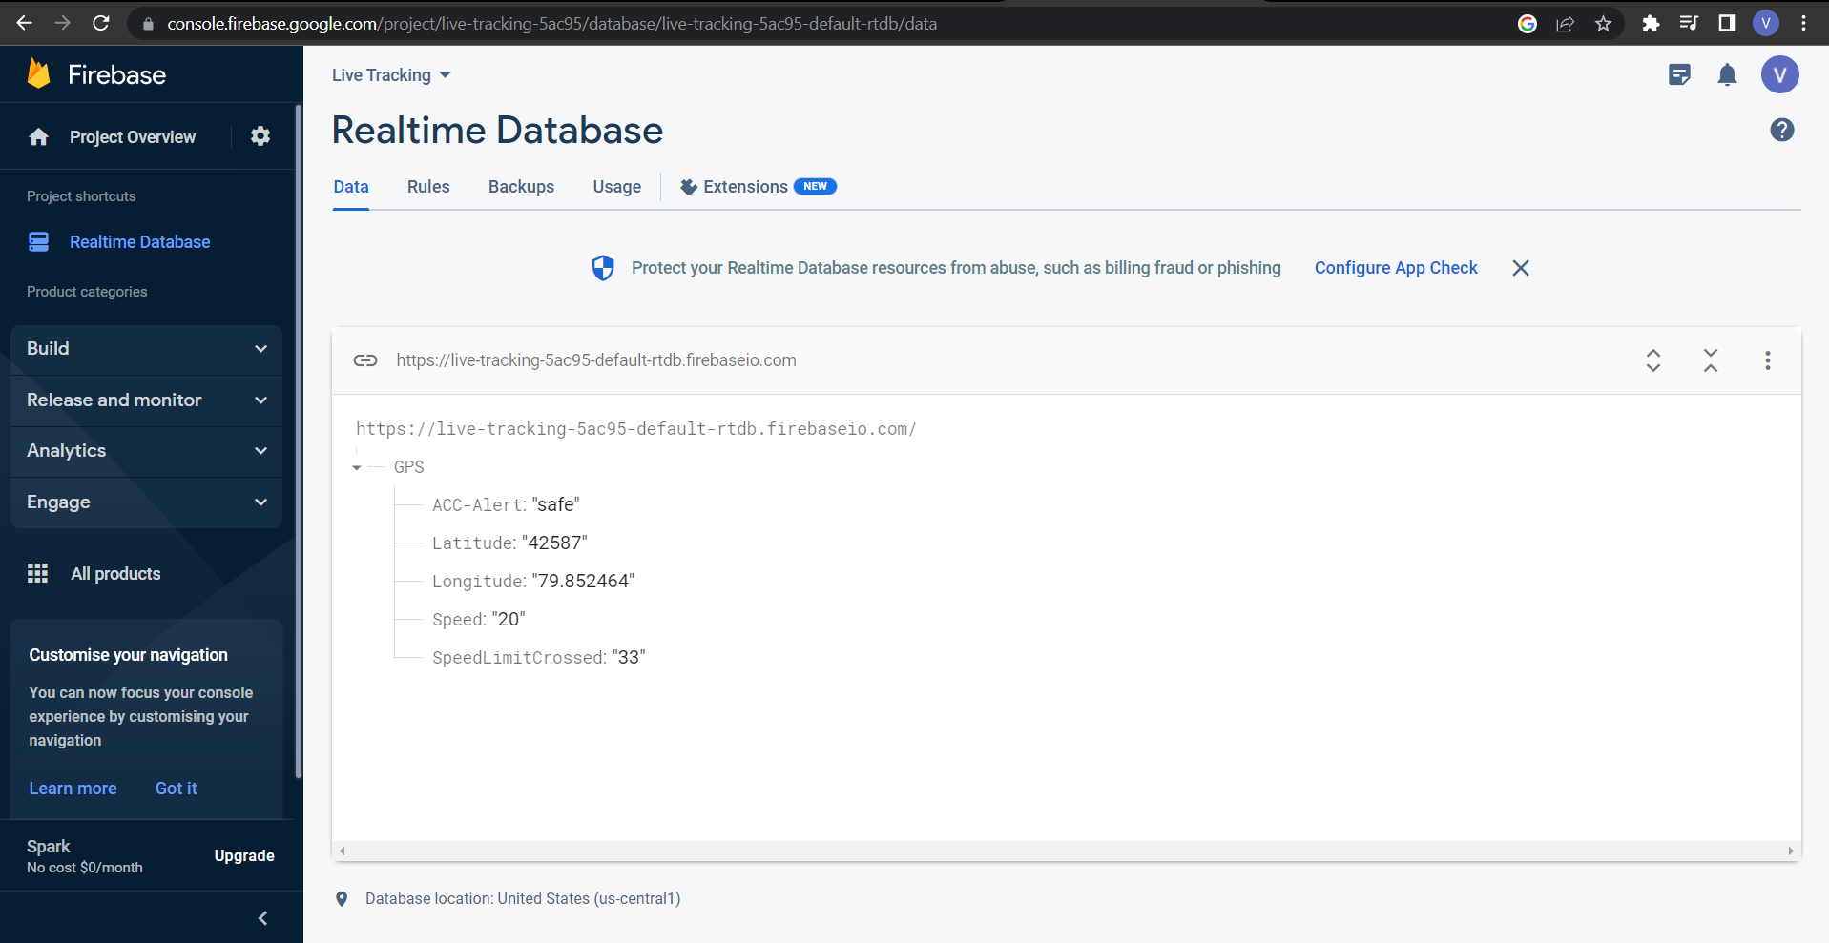

Slide 20
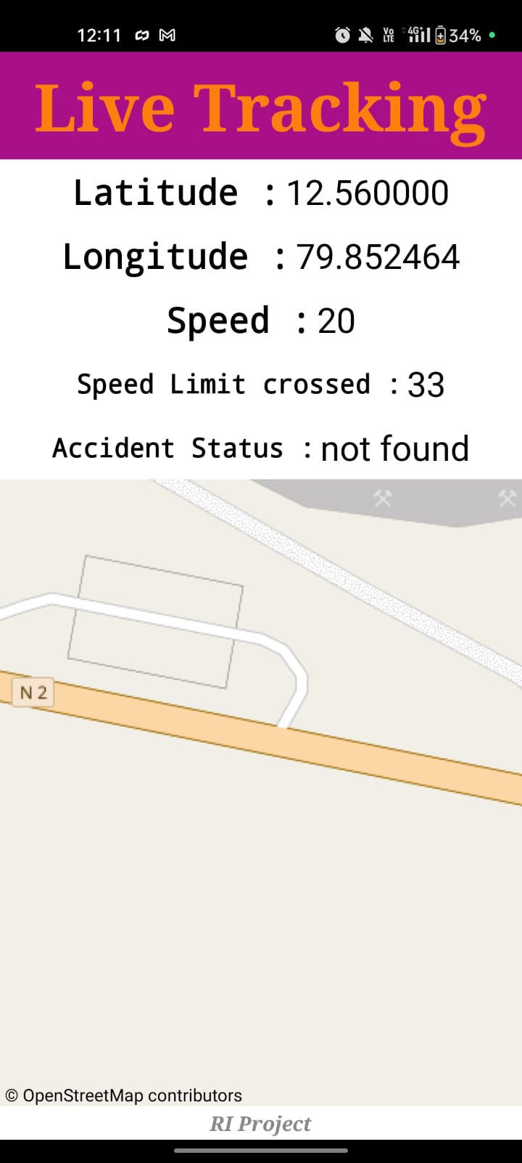
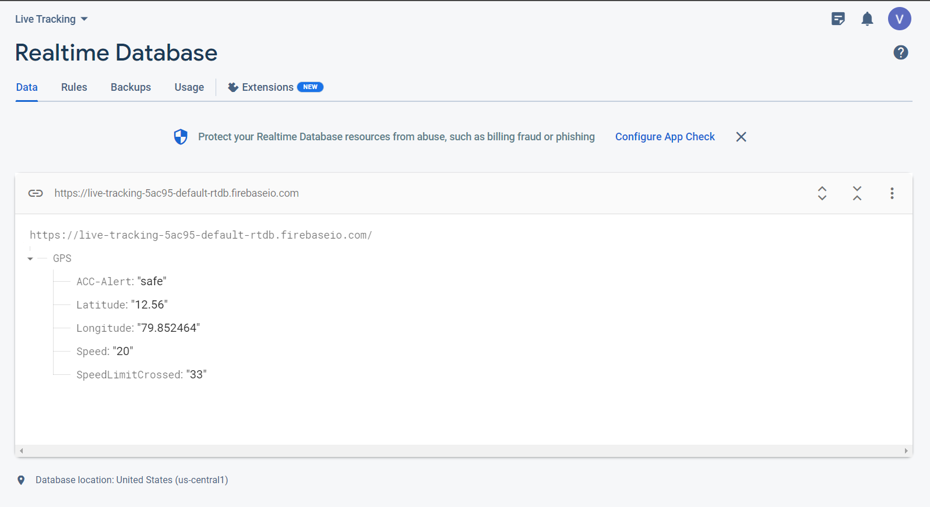

Slide 21
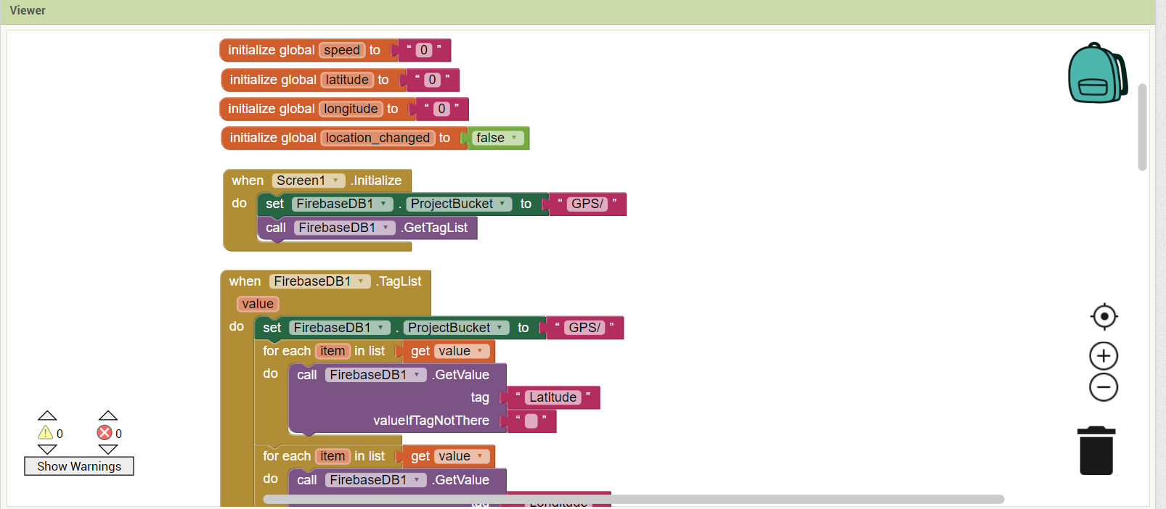
Code (Blocks):

Slide 22
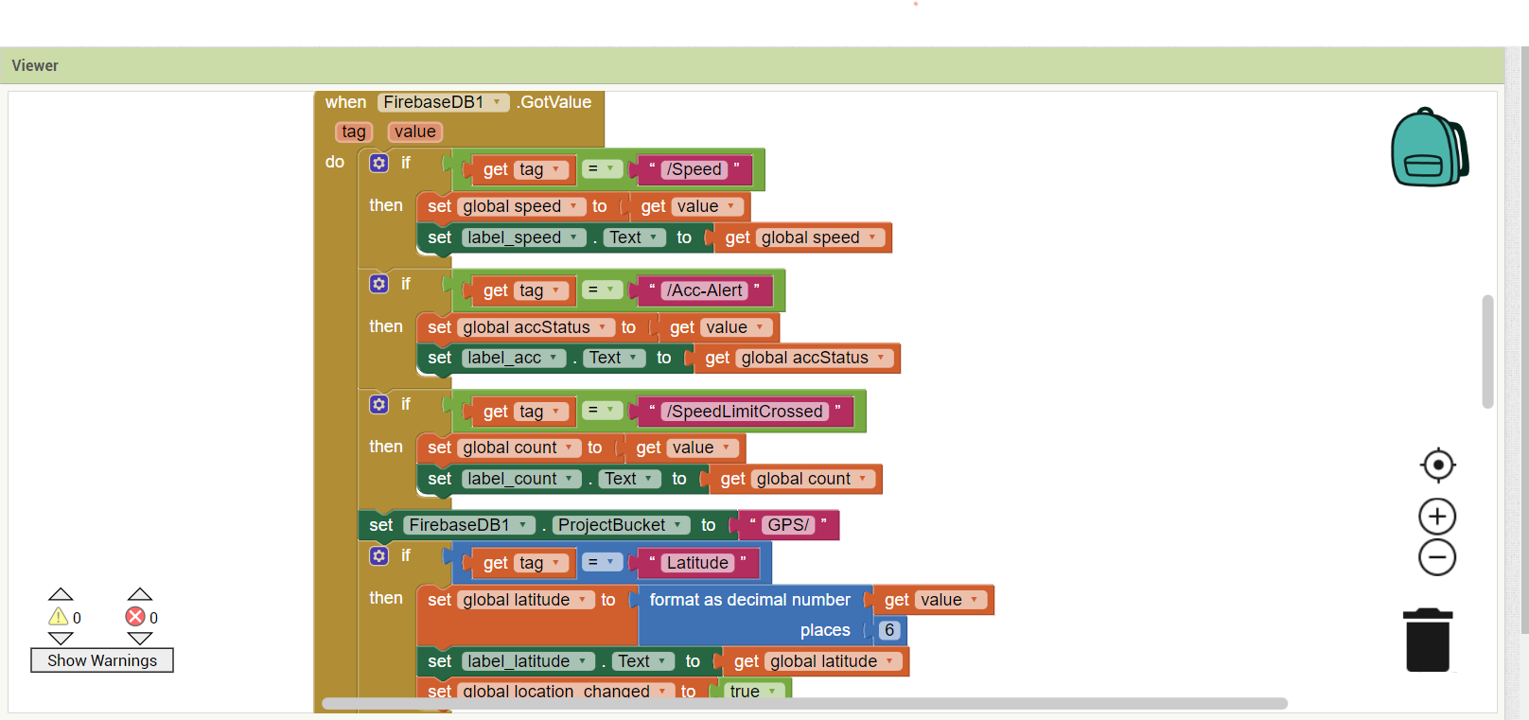

Slide 23
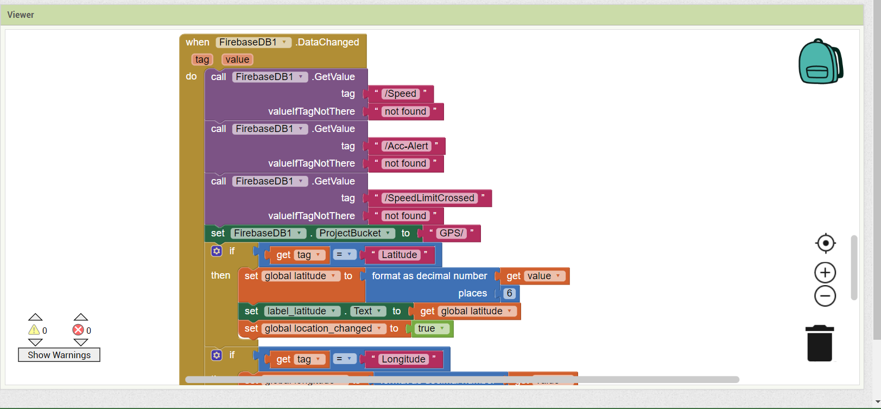

Slide 24

CONCLUSION

Slide 25

Conclusion
A vehicle speed alert and accident detection system can provide numerous benefits to drivers and passengers alike. By alerting drivers when they exceed a safe speed limit, this system can help prevent accidents caused by excessive speed.
Additionally, the system can detect
accidents and automatically alert emergency
services, potentially saving lives and reducing
the severity of injuries.

Slide 26


Implementing such a system requires the use of various sensors and software, including GPS, accelerometers. These components work together to accurately detect accidents and calculate vehicle speed.
While there may be some initial costs associated with installing and maintaining a speed alert and accident detection system, the potential benefits make it a worthwhile investment for anyone concerned with improving road safety.

Slide 27
Project Timeline
Mid - 1 Review
Final Review
Explaining briefly about the project
Demonstration of complete project.
Mid-2 Review
Collecting hardware components, basic outline, basic assembling of parts.

Slide 28

Team
1. Karthik Dasaradhan
2. Viraat Mindaguditi
3. Manoj K
4. Ramesh Palthya
5. Tsk Chaitanya

Slide 29
Thank You!

